Slide 1
XAML, WPF AND WPF STYLE
Author: Rory Oktariansyah
Last Revision: 8 September 2014
Date

Slide 2
Agenda (1)
Session 1
WPF Architecture
Features of WPF
XAML
Styling and Templating
Session 2
Use XAML to Create UI Elements
Using XAML Attributes to define the Look and Feel of UI Elements
Using WPF Framework Elements in Applications
Declaring, Using, and Debugging Basic WPF Controls Using XAML

Slide 3
Agenda (2)
Session 3
Declaring, Using, and Debugging Basic WPF Controls Programmatically With Basic Event Handlers Using Control Lifecycle
Showing, Hiding, and Focusing on UI Elements
Using the Layout System and Layout Controls
Session 4
Using WPF-Specific Controls
Styling WPF Controls

Slide 4
Agenda (3)
Session 5
Creating and Using Custom Controls
Using Data Binding
Using Input Validation and Dialogs
Creating and Using Context Menu
Session 6
Final Test

Slide 5
Objective
Understand XAML basics
Understand WPF basics
Understand WPF Styling basics

Slide 6
Session 1

Slide 7
WPF Overview
The Windows Presentation Foundation (WPF) is Microsoft’s next generation UI framework that provides developers with a unified programming model for building rich Windows smart client user experiences incorporating UI, media, and documents.

Slide 8
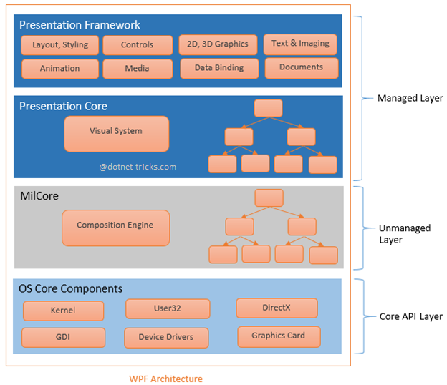
WPF Architecture (1)

Slide 9
WPF Architecture (2)
Managed Layer
Presentation Framework
Presentation Core
Written in managed code
Unmanaged Layer
Also called MILCore (Media Integration Layer)
Written in unmanaged code
Tight integration with DirectX.
Core API Layer
OS core components

Slide 10
Features of WPF (1)
Direct3D
Graphics, are rendered using Direct3D
Data binding
One-time – the client ignores updates on the server
One-way – the client has read-only access to data
Two-way – client can read from and write data to the server
One-way-to-source – the client has write-only access to data
Media services
Provides an integrated system for using vector and raster images, audio, and video
Provides an animation system and a 2D/3D rendering system

Slide 11
Features of WPF (2)
Templates
Style – a combination of property settings that can be applied to a UI template with a single property attribute
Templates – a mechanism for defining alternate UI for an element
Animations
Supports time-based animations
Imaging
Natively access Windows Imaging Component (WIC)
Documents
Natively supports paginated documents using the DocumentViewer and FlowDocumentReader

Slide 12
Features of WPF (3)
Text
Supports OpenType, TrueType, and OpenType CFF (Compact Font Format) fonts
Interoperability
UI elements from Windows Forms can also be used using ElementHost and WindowsFormHost
Alternative Input
Supports digital ink-related functionality and multi-touch input
Accessibility
Supports Microsoft UI Automation

Slide 13
XAML
XML is a markup language
XAML is a declarative application markup language
Introduced in WPF as its design language
Elements and attributes map to classes and properties in the underlying APIs
Advantages of using XAML:
Shorter and clearer to read
Clear separation of designer role (UI design) and developer (code and logic)
Native source for graphical design tools like

Slide 14
Styling
Styling to XAML is what CSS is to HTML
Styling allows developers and designers to create visually compelling effects
Styling allows developers and designers to create a consistent appearance for their product
Separation of presentation and logic

Slide 15
Templating
Every predefined control in the WPF that has a visual appearance also has a template that entirely defines the appearance
You can replace that default template with one of your own design

Slide 16


Questions?

Slide 17
Session 2

Slide 18
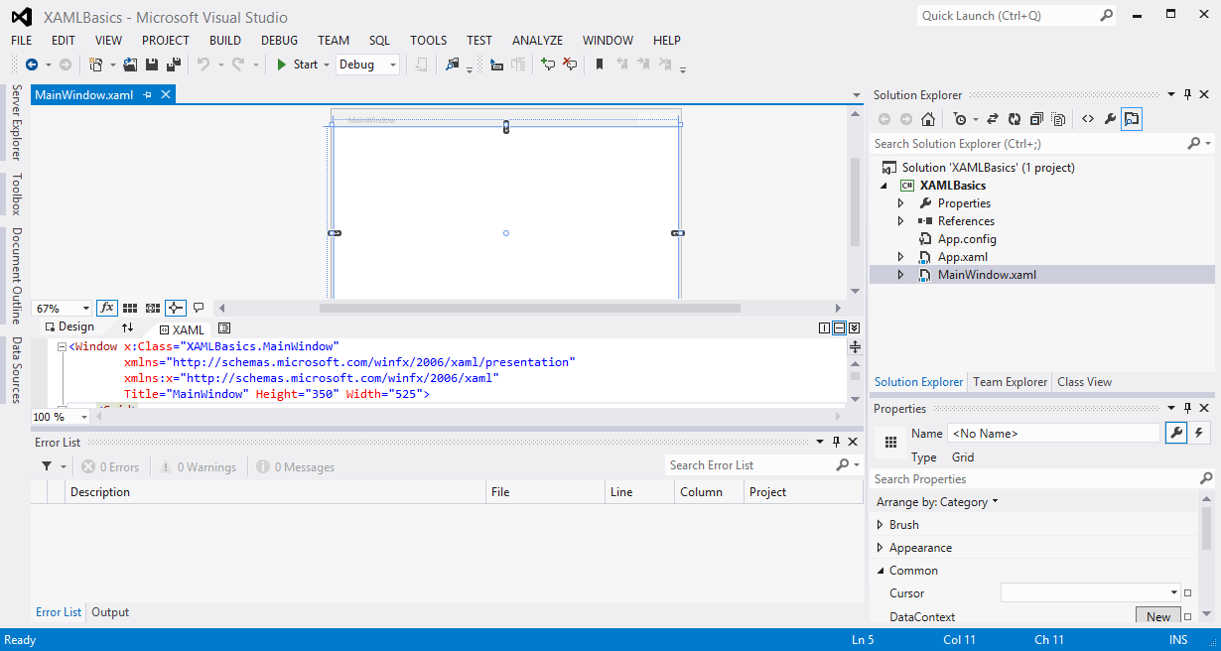
Use XAML to Create UI Elements Create A New WPF Project (1)
Example of a new project structure:

Slide 19
Use XAML to Create UI Elements Create A New WPF Project (2)
Example of an XAML file:

Slide 20
Use XAML to Create UI Elements XAML Namespace (1)
An extension of the concept of an XML namespace
Use XML namespace syntax
Use the convention of using URIs as namespace identifiers
Use prefixes to provide a means to reference multiple namespaces from the same markup source
Example:
xmlns="http://schemas.microsoft.com/winfx/2006/xaml/presentation"
xmlns:x="http://schemas.microsoft.com/winfx/2006/xaml"

Slide 21
Use XAML to Create UI Elements XAML Namespace (2)
You can map XML namespaces to assemblies using a series of tokens within an xmlns prefix declaration, similar to how the standard WPF and XAML-intrinsics XAML namespaces are mapped to prefixes
The XAML namespace syntax takes the following possible named tokens and following values:
clr-namespace
Assembly
MainWindow.xaml:
<Window x:Class="XAMLBasics.MainWindow"
xmlns="http://schemas.microsoft.com/winfx/2006/xaml/presentation"
xmlns:x="http://schemas.microsoft.com/winfx/2006/xaml"
xmlns:custom="clr-namespace:SDKSample;assembly=SDKSampleLibrary"
Title="MainWindow" Height="350" Width="525">
<Grid>
<custom:ExampleClass/>
</Grid>
</Window>
Notes:
The XAML namespace syntax takes the following possible named tokens and following values:
clr-namespace – the namespace declared within the assembly that contains the public types to expose as elements
Assembly= – the assembly that contains some or all of the referenced CLR namespace

Slide 22
Use XAML to Create UI Elements Add a Control to a Window Using XAML
Example:
<Button Name="myButton">Mitrais Certification Program</Button>

Slide 23
Use XAML to Create UI Elements Using XAML Attributes to define the Look and Feel of UI Elements (1)
XAML attributes are very much like XML attributes, which determine the properties of the object element
Two types of attribute declaration:
Inline Attributes (attribute syntax)
Explicitly-Declared Attributes (property element syntax)
Primitive properties of an object can often be expressed as attributes of the object element (inline declaration)
For complex properties, a different syntax known as property element syntax, or explicit attribute declaration, can be used

Slide 24
Use XAML to Create UI Elements Using XAML Attributes to define the Look and Feel of UI Elements (2)
Inline attribute example:
<Button Name="myButton" Background="Blue" Foreground="Red">Mitrais Certification Program</Button>
Explicitly-declared attribute example:
<Button>
Mitrais Certification Program
<Button.Name>
myButton
</Button.Name>
<Button.Background>
<SolidColorBrush Color="Blue"/>
</Button.Background>
<Button.Foreground>
<SolidColorBrush Color="Red"/>
</Button.Foreground>
</Button>

Slide 25
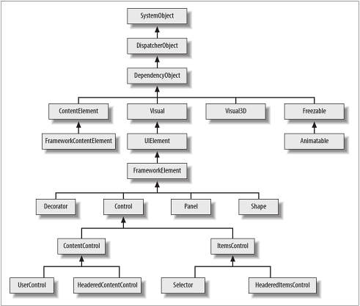
Use XAML to Create UI Elements Using WPF Framework Elements in Applications (1)
WPF core types:

Slide 26
Use XAML to Create UI Elements Using WPF Framework Elements in Applications (2)
WPF core types:
DispatcherObject – base class of any type associated with a Dispatcher
DependencyObject – employs WPF’s dependency property system, taking advantage of data binding
Visual – the abstract base class of all 2D elements
Visual3D – all 3D elements derive from Visual3D
UIElement – introduces the notion of CommandBindings
FrameworkElement – the base class of the majority of visible elements in WPF
Decorator – the base class for elements that contain a single child
Notes:
Dispatcher – WPF’s message processing system
CommandBindings allows developers to define functionality in terms of a command end point
FrameworkElement derives from UIElement

Slide 27
Use XAML to Create UI Elements Using WPF Framework Elements in Applications (3)
WPF core types:
Panel – the abstract base class of elements that contain and arrange multiple child elements
Shape – the abstract base class of graphical shape elements that can be added to the UI
Control – the base class for elements that offer a particular interactive behavior
ContentControl – a specialized type of Control; the base class for any control that can host a single content, which goes in the Content property
ItemsControl – the base class for all controls that present lists or trees of items
HeaderedItemsControl – derives from ItemsControl; adds a Header property designed to hold a single item of content

Slide 28
Use XAML to Create UI Elements Using WPF Framework Elements in Applications (4)
WPF core types:
FrameworkContentElement – the base class of all types in WPF’s text object model
Freezable – describe features of the user interface rather than being UI elements
Animatable – provides WPF’s animation system with the hooks it needs to change properties over time
Notes:
FrameworkContentElement do not generate their own appearance
Freezable examples: brushes, geometries

Slide 29
Declaring, Using, and Debugging Basic WPF Controls Using XAML Button (1)
Buttons are the most commonly used control in WPF applications
MainWindow.xaml:
<Button Name="myButton" Background="Green"
BorderBrush="Black" BorderThickness="1"
Click="myButton_Click" ClickMode="Press">
Mitrais Certification Program
</Button>
MainWindow.xaml.cs:
private void myButton_Click(object sender, RoutedEventArgs e)
{
myButton.Background = Brushes.Red;
}

Slide 30
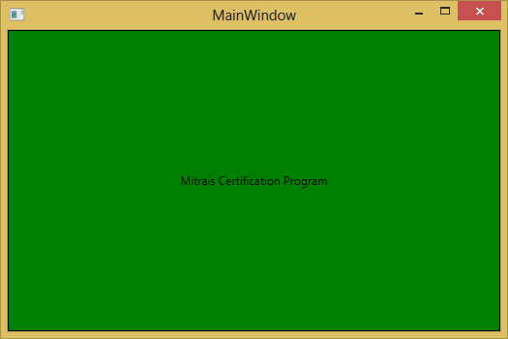
Declaring, Using, and Debugging Basic WPF Controls Using XAML Button (2)
Result:

Slide 31
Declaring, Using, and Debugging Basic WPF Controls Using XAML TextBlock (1)
Allows you to put text on the screen
Behaves like a Label control does, but simpler and less resource demanding
MainWindow.xaml:
<StackPanel>
<TextBlock Foreground="Red">
Mitrais Certification Program is a comprehensive certification program aimed to<LineBreak/>empower the developers
</TextBlock>
<TextBlock Foreground="Green" TextTrimming="CharacterEllipsis">
Mitrais Certification Program is a comprehensive certification program aimed to empower the developers
</TextBlock>
<TextBlock Foreground="Blue" TextWrapping="Wrap">
Mitrais Certification Program is a comprehensive certification program aimed to empower the developers
</TextBlock>
</StackPanel>

Slide 32
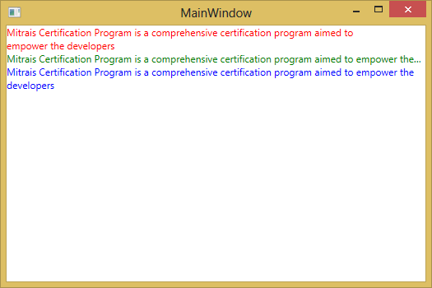
Declaring, Using, and Debugging Basic WPF Controls Using XAML TextBlock (2)
Result:

Slide 33
Declaring, Using, and Debugging Basic WPF Controls Using XAML Label (1)
Looks like the TextBlock control
Instead of a Text property, Label has a Content property
Label can host any kind of control directly inside of it, instead of just text
MainWindow.xaml:
<Label>
Mitrais Certification Program
</Label>

Slide 34
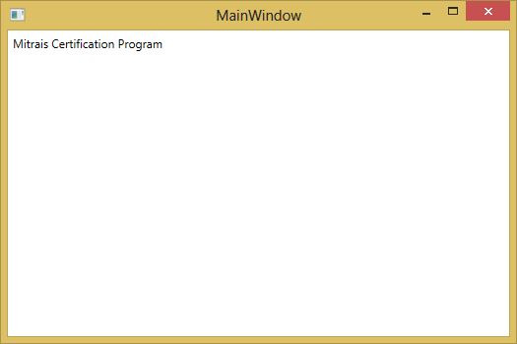
Declaring, Using, and Debugging Basic WPF Controls Using XAML Label (2)
Result:

Slide 35
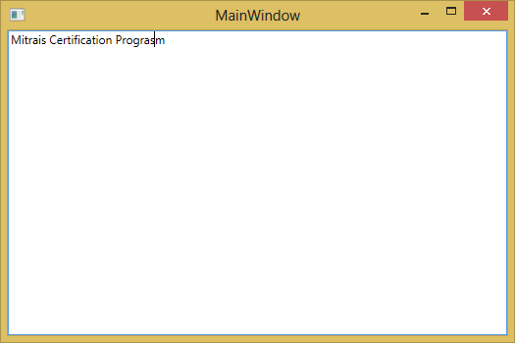
Declaring, Using, and Debugging Basic WPF Controls Using XAML TextBox
MainWindow.xaml:
<TextBox>
Mitrais Certification Program
</TextBox>
Result:

Slide 36
Declaring, Using, and Debugging Basic WPF Controls Using XAML CheckBox (1)
Allows the end-user to toggle an option on or off
Usually reflecting a Boolean value in the code-behind
MainWindow.xaml:
<StackPanel>
<Label FontWeight="Bold">Mitrais Certification Program Course Options</Label>
<CheckBox>XAML</CheckBox>
<CheckBox>WPF</CheckBox>
<CheckBox>WPF Style</CheckBox>
</StackPanel>

Slide 37
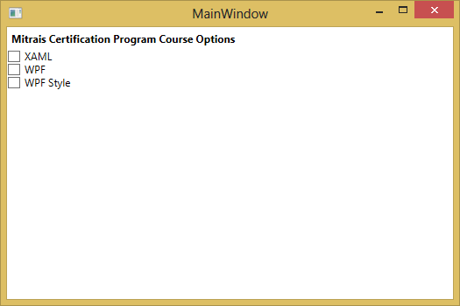
Declaring, Using, and Debugging Basic WPF Controls Using XAML CheckBox (2)
Result:

Slide 38
Declaring, Using, and Debugging Basic WPF Controls Using XAML RadioButton (1)
Allows you to give your user a list of possible options, with only one of them selected at the same time
MainWindow.xaml:
<StackPanel>
<Label FontWeight="Bold">Are you satisfied with the Mitrais Certification Program?</Label>
<RadioButton>Yes</RadioButton>
<RadioButton>No</RadioButton>
<RadioButton>Not Sure</RadioButton>
</StackPanel>

Slide 39
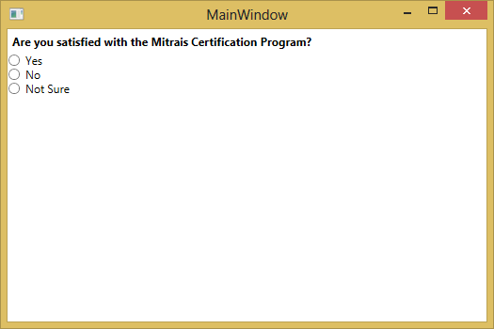
Declaring, Using, and Debugging Basic WPF Controls Using XAML RadioButton (2)
Result:

Slide 40
Declaring, Using, and Debugging Basic WPF Controls Using XAML DataGrid (1)
Provides a flexible way to display a collection of data in rows and columns
Includes built-in column types and a template column for hosting custom content
MainWindow.xaml:
<StackPanel>
<DataGrid ItemsSource="{Binding Customers}"/>
</StackPanel>

Slide 41
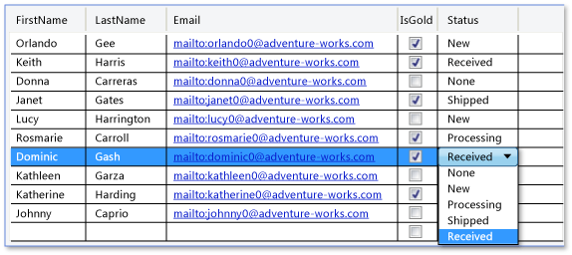
Declaring, Using, and Debugging Basic WPF Controls Using XAML DataGrid (2)
Result:

Slide 42
Questions?

Slide 43
Session 3

Slide 44
Declaring, Using, and Debugging Basic WPF Controls Programmatically With Basic Event Handlers Using Control Lifecycle (1)
Besides using XAML, we can fully use the code-behind to create and add controls to a window
Creating basic event handlers can also be done programmatically
MainWindow.xaml:
<Window x:Class="CodeBehindControls.MainWindow"
xmlns="http://schemas.microsoft.com/winfx/2006/xaml/presentation"
xmlns:x="http://schemas.microsoft.com/winfx/2006/xaml"
Title="MainWindow" Height="350" Width="525" Loaded="Window_Loaded">
<StackPanel Name="myStackPanel">
</StackPanel>
</Window>

Slide 45
Declaring, Using, and Debugging Basic WPF Controls Programmatically With Basic Event Handlers Using Control Lifecycle (2)
MainWindow.xaml.cs:
private void Window_Loaded(object sender, RoutedEventArgs e)
{
Button myButton = new Button();
myButton.Content = "Click Me!";
myButton.Click += myButton_Click;
myStackPanel.Children.Add(myButton);
}
void myButton_Click(object sender, RoutedEventArgs e)
{
MessageBox.Show("Clicked");
}

Slide 46
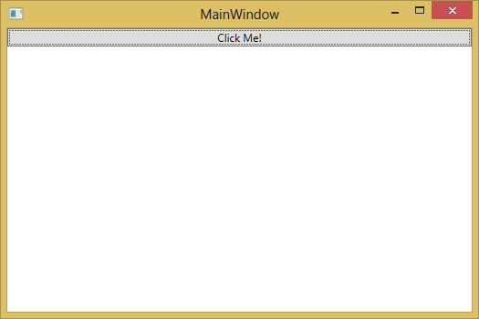
Declaring, Using, and Debugging Basic WPF Controls Programmatically With Basic Event Handlers Using Control Lifecycle (3)
Result (Debug):

Slide 47
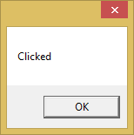
Declaring, Using, and Debugging Basic WPF Controls Programmatically With Basic Event Handlers Using Control Lifecycle (4)
Result (Clicked):

Slide 48
Declaring, Using, and Debugging Basic WPF Controls Programmatically With Basic Event Handlers Using Control Lifecycle (5)
Three common control lifetime events:
Initialized –corresponds to the initialization of the object
Loaded – raised before the final rendering
Unloaded – raised last
Notes:
Three common control lifetime events:
Initialized – roughly corresponds to the initialization of the object by the call to its constructor; guaranteed that all properties of the object are set
Loaded – raised before the final rendering; after the layout system has calculated all necessary values for rendering
Unloaded – raised last; initiated by either the presentation source or the visual parent being removed; data binding, resource references, and styles may not be set to their normal or last known run-time value

Slide 49
Showing, Hiding, and Focusing on UI Elements (1)
You can change a control’s visibility to show or hide it
Visibility.Visible – makes the control visible
Visibility.Hidden – hides the control, but still use up the space in the layout system
Visibility.Collapsed – hides the control and not use up space.
The Visibility property applies for both Window and its elements
To focus on a UI element, the common method is to use the Focus() method
For Window objects, Hide() and Show() methods can be used

Slide 50
Showing, Hiding, and Focusing on UI Elements (2)
MainWindow.xaml:
<Window x:Class="Focusing.MainWindow"
xmlns="http://schemas.microsoft.com/winfx/2006/xaml/presentation"
xmlns:x="http://schemas.microsoft.com/winfx/2006/xaml"
Title="MainWindow" Height="350" Width="525" Loaded="Window_Loaded">
<Grid>
</Grid>
</Window>
MainWindow.xaml.cs:
private void Window_Loaded(object sender, RoutedEventArgs e)
{
this.Visibility = System.Windows.Visibility.Collapsed;
}

Slide 51
Using the Layout System and Layout Controls Layout (1)
A recursive system that leads to an element being sized, positioned, and drawn
Layout describes the process of measuring and arranging the members of a Panel element’s Children collection
The process that occurs when the layout system is invoked
A child UIElement has its core properties measured
Sizing properties defined on FrameworkElement are evaluated
Panel-specific logic is applied
Content is arranged
The Children collection is drawn on the screen
The process is invoked again if additional Children are added to the collection
Notes:
The process that occurs when the layout system is invoked
A child UIElement begins the layout process by first having its core properties measured
Sizing properties defined on FrameworkElement are evaluated, such as Width, Height, and Margin
Panel-specific logic is applied, such as Dock direction or stacking Orientation
Content is arranged after all children have been measured
The Children collection is drawn on the screen
The process is invoked again if additional Children are added to the collection, a LayoutTransform is applied, or the UpdateLayout method is called

Slide 52
Using the Layout System and Layout Controls Layout (2)
Layout completes two passes for each member of the Children collection: a measure pass and an arrange pass
During the measure pass, each member of the Children collection is evaluated
The Measure process begins with a call to the Measure method
The ultimate goal of the measure pass is for the child element to determine its DesiredSize
The arrange pass begins with a call to the Arrange method
During the arrange pass, the parent Panel element generates a rectangle that represents the bounds of the child

Slide 53
Using the Layout System and Layout Controls Layout Panel Controls (1)
WPF includes a group of elements that derive from Panel
Panel allows many complex layouts
Canvas
Defines an area within which you can explicitly position child elements by coordinates relative to the Canvas area
The most basic layout panel in WPF
Its child elements are positioned by explicit coordinates: Canvas.Left, Canvas.Top, Canvas.Bottom, and Canvas.Right attached properties
Attached properties are the properties that are not owned by a class, but available to it via its parent (usually a container control)
DockPanel
Defines an area within which you can arrange child elements either horizontally or vertically, relative to each other
Provides an easy docking of elements to the left, right, top, bottom or center of the panel
The dock side of an element is defined by the attached property DockPanel.Dock
Grid
Arranges its child controls in a tabular structure of rows and columns
Similar to the HTML table but more flexible
A cell can contain multiple controls; they can span over multiple cells and even overlap themselves

Slide 54
Using the Layout System and Layout Controls Layout Panel Controls (2)
UniformGrid
Provides a similar layout to that given by the Grid layout control
Its child controls are organized into a tabular structure of rows and columns
The column widths and row heights cannot be modified
StackPanel
A simple and useful layout panel
It stacks its child elements below or beside each other, dependening on its orientation
The dock side of an element is defined by the attached property DockPanel.Dock
The stack panel aligns the two buttons depending on their desired size
ViewBox
It does not resize the content, but it transforms it
It is about the same behavior as if you set the Stretch property on an Image or Path to Uniform
WrapPanel
Similar to the StackPanel, but it does not just stack all child elements to one row, it wraps them to new lines if no space is left
Can be used to arrange tabs of a tab control, menu items in a toolbar or items in a Windows Explorer-like list

Slide 55
Using the Layout System and Layout Controls Margins, Padding, and Alignment (1)
Fine control of positioning requires an understanding of the HorizontalAlignment, Margin, Padding and VerticalAlignment properties
MainWindow.xaml:
<Window x:Class="MarginPaddingAlignment.MainWindow"
xmlns="http://schemas.microsoft.com/winfx/2006/xaml/presentation"
xmlns:x="http://schemas.microsoft.com/winfx/2006/xaml"
Title="MainWindow" Height="220" Width="400">
<Border Background="LightBlue" BorderBrush="Black" BorderThickness="2" Padding="15">
<StackPanel Background="White" HorizontalAlignment="Center" VerticalAlignment="Top">
<TextBlock Margin="5,0,5,0" FontSize="18" HorizontalAlignment="Center">Alignment, Margin and Padding Sample</TextBlock>
<Button HorizontalAlignment="Left" Margin="20">Button 1</Button>
<Button HorizontalAlignment="Right" Margin="10">Button 2</Button>
<Button HorizontalAlignment="Stretch" Margin="0">Button 3</Button>
</StackPanel>
</Border>
</Window>

Slide 56
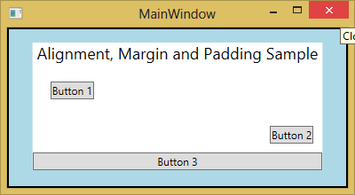
Using the Layout System and Layout Controls Margins, Padding, and Alignment (2)
Result:

Slide 57
Questions?

Slide 58
Session 4

Slide 59
Using WPF-Specific Controls AccessText
Converts a character preceded by an underscore to an Access Key
The Access Key is registered and therefore raises an event when pressed
Example (XAML)
<Button Name="Button1" Width="120" Height="50" Margin="33,70,59,124"
FontSize="16" Click="Button1_Click">
<AccessText>_Click Me</AccessText>
</Button>

Slide 60
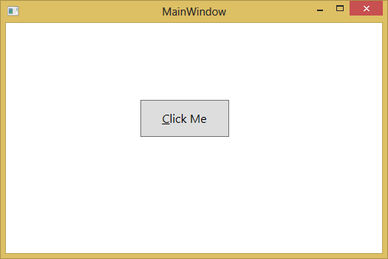
Using WPF-Specific Controls AccessText
Result:

Slide 61
Using WPF-Specific Controls DocumentViewer (1)
Designed to display fixed document content
Provides an intuitive user interface that provides built-in support for common operations
Provides access to pages of content through a familiar scrolling mechanism
DocumentViewer is designed to display content in a read-only manner; editing or modification of content is not available and is not supported
MainWindow.xaml:
<DocumentViewer x:Name="documentViewer1">
<FixedDocument>
</FixedDocument>
</DocumentViewer>

Slide 62
Using WPF-Specific Controls DocumentViewer (2)
MainWindow.xaml.cs:
using System;
using System.Collections.Generic;
using System.Linq;
using System.Text;
using System.Threading.Tasks;
using System.Windows;
using System.Windows.Controls;
using System.Windows.Data;
using System.Windows.Documents;
using System.Windows.Input;
using System.Windows.Media;
using System.Windows.Media.Imaging;
using System.Windows.Navigation;
using System.Windows.Shapes;
using System.Windows.Xps.Packaging;
namespace DocumentViewer
{
/// <summary>
/// Interaction logic for MainWindow.xaml
/// </summary>
public partial class MainWindow : Window
{
public MainWindow()
{
InitializeComponent();
XpsDocument document1 = new XpsDocument(@"D:\Text.xps", System.IO.FileAccess.Read);
documentViewer1.Document = document1.GetFixedDocumentSequence();
}
}
}

Slide 63
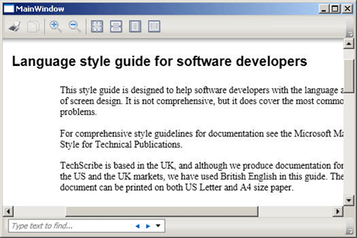
Using WPF-Specific Controls DocumentViewer (3)
Result:

Slide 64
Using WPF-Specific Controls FlowDocumentReader (1)
Includes features that enable the user to dynamically choose between various viewing modes
Single-page (page-at-a-time)
Two-page-at-a-time (book reading format)
Continuous scrolling (bottomless)
MainWindow.xaml:
<FlowDocumentReader>
<FlowDocument>
<Paragraph>
<Bold>Some bold text in the paragraph.</Bold>
Some text that is not bold.
</Paragraph>
<List>
<ListItem>
<Paragraph>ListItem 1</Paragraph>
</ListItem>
<ListItem>
<Paragraph>ListItem 2</Paragraph>
</ListItem>
<ListItem>
<Paragraph>ListItem 3</Paragraph>
</ListItem>
</List>
</FlowDocument>
</FlowDocumentReader>

Slide 65
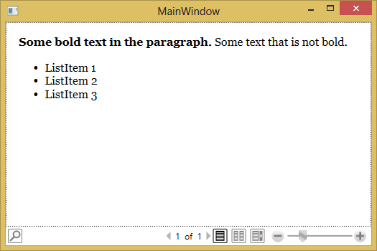
Using WPF-Specific Controls DocumentViewer (3)
Result:

Slide 66
Styling WPF Controls Styling Fundamentals (1)
The concept of styles let you remove all properties values from the individual user interface elements and combine them into a style
A style consists of a list of setters
The styling idea is quite similar to Cascading Styles Sheets (CSS)
To apply the style to a control we set the Style property to our style.
To get the style from the resources we use the {StaticResource [resourceKey]} markup extension

Slide 67

Styling WPF Controls Styling Fundamentals (2)
MainWindow.xaml:
<Window.Resources>
<Style x:Key="myStyle" TargetType="Button">
<Setter Property="Background" Value="Orange" />
<Setter Property="FontStyle" Value="Italic" />
<Setter Property="Padding" Value="8,4" />
<Setter Property="Margin" Value="4" />
</Style>
</Window.Resources>
<StackPanel Orientation="Horizontal" VerticalAlignment="Top">
<Button Style="{StaticResource myStyle}">Styles</Button>
<Button Style="{StaticResource myStyle}">are</Button>
<Button Style="{StaticResource myStyle}">cool</Button>
</StackPanel>
Result:

Slide 68
Styling WPF Controls Styling Fundamentals (3)
Example of style inheritance (XAML):
<Style x:Key="baseStyle">
<Setter Property="FontSize" Value="12" />
<Setter Property="Background" Value="Orange" />
</Style>
<Style x:Key="boldStyle" BasedOn="{StaticResource baseStyle}">
<Setter Property="FontWeight" Value="Bold" />
</Style>

Slide 69
Styling WPF Controls Resources (1)
A resource is an object that can be reused in different places in your application
You can also create and access resources by using code, or interchangeably between code and Extensible Application Markup Language (XAML)
Every framework-level element (FrameworkElement or FrameworkContentElement) has a Resource property
Notes:
Examples of resources include brushes and styles
Resource property, which is the property that contains the resources (as a ResourceDictionary) that a resource defines

Slide 70
Styling WPF Controls Resources (2)
Each resource in a resource dictionary must have a unique key
You can reference the resource to be used for a property value by using a resource markup extension syntax that specifies the key name
Example (XAML):
<Button Background="{StaticResource MyBrush}"/>
<Ellipse Fill="{StaticResource MyBrush}"/>

Slide 71
Styling WPF Controls Static and Dynamic Resources
A resource can be referenced as either a static resource or a dynamic resource using markup extension
The StaticResource Markup Extension processes a key by looking up the value for that key in all available resource dictionaries
The DynamicResource processes a key by creating an expression, and that expression remains unevaluated until the application is actually run, at which time the expression is evaluated and provides a value
Notes:
Markup extension is a feature of XAML whereby you can specify an object reference by having the markup extension process the attribute string and return the object to a XAML loader

Slide 72
Styling WPF Controls Merged Resource Dictionaries (1)
Merged Resource Dictionaries feature provides a way to define the resources portion of a WPF application outside of the compiled XAML application
In markup, you use the following syntax to introduce a merged resource dictionary into a page:
<Page.Resources>
<ResourceDictionary>
<ResourceDictionary.MergedDictionaries>
<ResourceDictionary Source="myresourcedictionary.xaml"/>
<ResourceDictionary Source="myresourcedictionary2.xaml"/>
</ResourceDictionary.MergedDictionaries>
</ResourceDictionary>
</Page.Resources>

Slide 73
Styling WPF Controls Merged Resource Dictionaries (2)
The ResourceDictionary that introduces a merged resource dictionary cannot have an x:Key Directive
Typically, each ResourceDictionary within the MergedDictionaries collection specifies a Source attribute
The value of Source should be a uniform resource identifier (URI) that resolves to the location of the resources file to be merged
The destination of that URI must be another XAML file, with ResourceDictionary as its root element

Slide 74
Styling WPF Controls Styles and Resources
You can use a style on any element that derives from FrameworkElement or FrameworkContentElement
Styles obey the same scoping rules that apply to all resources
To assign a named style to an element programmatically, get the style from the resources collection and assign it to the element's Style property
Example:
textblock1.Style = (Style)(this.Resources["TitleText"]);
Once a style has been applied, it is sealed and cannot be changed
If you want to dynamically change a style that has already been applied, you must create a new style to replace the existing one

Slide 75
Styling WPF Controls Control Templates (1)
ControlTemplate of a control defines the appearance of the control
You can change the structure and appearance of a control by defining a new ControlTemplate for the control
A ControlTemplate specifies the visual structure and visual behavior of a control
The control template is often included in a style that contains other property settings
The following code sample shows a simple control template for a button with an ellipse shape
<Style x:Key="DialogButtonStyle" TargetType="Button">
<Setter Property="Template">
<Setter.Value>
<ControlTemplate TargetType="{x:Type Button}">
<Grid>
<Ellipse Fill="{TemplateBinding Background}"
Stroke="{TemplateBinding BorderBrush}"/>
<ContentPresenter HorizontalAlignment="Center"
VerticalAlignment="Center"/>
</Grid>
</ControlTemplate>
</Setter.Value>
</Setter>
</Style>
<Button Style="{StaticResource DialogButtonStyle}" />

Slide 76
Styling WPF Controls Control Templates (2)
When you create a custom control template and you want to define a placeholder that renders the content, you can use the ContentPresenter
To display the content of another property you can set the ContentSource to the name of the property you like

Slide 77
Styling WPF Controls Data Templates
Data Templates are a similar concept as Control Templates
Data Templates give you a very flexible and powerful solution to replace the visual appearance of a data item in a control
You can easily bind against the data context to display various members of your data object

Slide 78
Questions?

Slide 79
Session 5

Slide 80
Creating and Using User-Defined Controls
WPF has two concepts of user-defined controls: UserControls and CustomControls
UserControl
Composes multiple existing controls into a reusable "group“
Consists of a XAML and a code behind file
Cannot be styled/template
Derives from UserControl
CustomControl (extend existing control)
Extends an existing control with additional features
Consists of a code file and a default style in Themes/Generic.xaml
Can be styled/template
The best approach to build a control library

Slide 81
Creating and Using User-Defined Controls UserControl (1)
In this example, the user (composite) control will be a file browser control

Slide 82
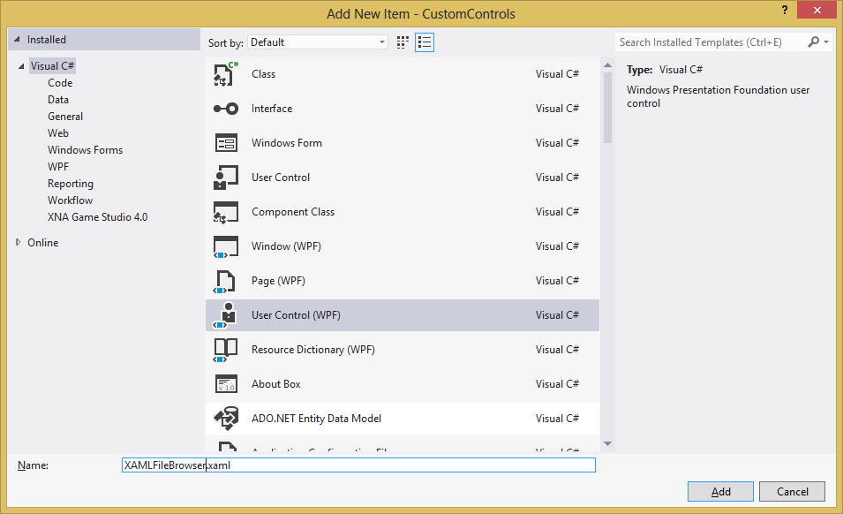
Creating and Using User-Defined Controls UserControl (2)
Add User Control screen

Slide 83
Creating and Using User-Defined Controls UserControl (3)
XAMLFileBrowser.xaml:
<UserControl xmlns="http://schemas.microsoft.com/winfx/2006/xaml/presentation"
xmlns:x="http://schemas.microsoft.com/winfx/2006/xaml"
xmlns:mc="http://schemas.openxmlformats.org/markup-compatibility/2006"
xmlns:d="http://schemas.microsoft.com/expression/blend/2008"
mc:Ignorable="d"
x:Class="CustomControls.XamlFileBrowser"
x:Name="XAMLFileBrowserControl"
d:DesignHeight="39" d:DesignWidth="397">
<Grid x:Name="LayoutRoot">
<Grid.ColumnDefinitions>
<ColumnDefinition Width="0.352*"/>
<ColumnDefinition Width="0.648*"/>
</Grid.ColumnDefinitions>
<TextBox x:Name="FBCTextBox" Margin="4,10.313,137,4.001" Text="TextBox" TextWrapping="Wrap" Grid.ColumnSpan="2" TextChanged="FBCTextBox_TextChanged" />
<Button x:Name="FBCButton" HorizontalAlignment="Right" Margin="0,8,13,4" Width="111" Content="Browse"
Grid.Column="1" Click="FBCButton_Click" />
</Grid>
</UserControl>

Slide 84
Creating and Using User-Defined Controls UserControl (4)
XAMLFileBrowser.xaml.cs (code-behind) – part 1:
using System;
using System.Collections.Generic;
using System.Linq;
using System.Text;
using System.Threading.Tasks;
using System.Windows;
using System.Windows.Controls;
using System.Windows.Data;
using System.Windows.Documents;
using System.Windows.Input;
using System.Windows.Media;
using System.Windows.Media.Imaging;
using System.Windows.Navigation;
using System.Windows.Shapes;
namespace CustomControls
{
/// <summary>
/// Interaction logic for XAMLFileBrowser.xaml
/// </summary>
public partial class XAMLFileBrowser : UserControl
{
public string FileName
{
get { return FBCTextBox.Text; }
set { FBCTextBox.Text = value; }
}
public event EventHandler<EventArgs> FileNameChanged;

Slide 85
Creating and Using User-Defined Controls UserControl (5)
XAMLFileBrowser.xaml.cs (code-behind) – part 2:
public XAMLFileBrowser()
{
InitializeComponent();
}
private void FBCButton_Click(object sender, RoutedEventArgs e)
{
Microsoft.Win32.OpenFileDialog openFileDlg = new Microsoft.Win32.OpenFileDialog();
if (openFileDlg.ShowDialog() == true)
this.FileName = openFileDlg.FileName;
}
private void FBCTextBox_TextChanged(object sender, TextChangedEventArgs e)
{
e.Handled = true;
if (FileNameChanged != null)
FileNameChanged(this, EventArgs.Empty);
}
}
}

Slide 86
Creating and Using User-Defined Controls UserControl (6)
MainWindow.xaml:
<Window x:Class="CustomControls.MainWindow"
xmlns="http://schemas.microsoft.com/winfx/2006/xaml/presentation"
xmlns:x="http://schemas.microsoft.com/winfx/2006/xaml"
xmlns:local="clr-namespace:CustomControls"
Title="MainWindow" Height="100" Width="525">
<Grid>
<local:XAMLFileBrowser />
</Grid>
</Window>

Slide 87
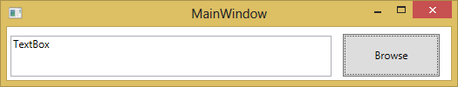
Creating and Using User-Defined Controls UserControl (7)
Result:

Slide 88
Creating and Using User-Defined Controls CustomControl (1)
CustomControl – where we extend an existing control to suit our needs
The example custom control will be a button that can be decorated with an image

Slide 89
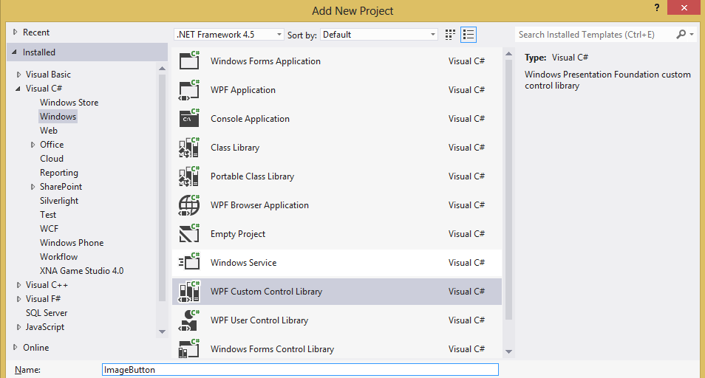
Creating and Using User-Defined Controls CustomControl (2)
CustomControl Library Project screen:

Slide 90
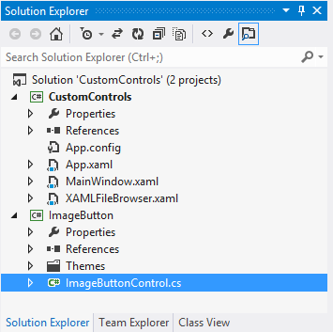
Creating and Using User-Defined Controls CustomControl (3)
CustomControl Library project structure:

Slide 91
Creating and Using User-Defined Controls CustomControl (4)
ImageButtonControl.cs:
public class ImageButtonControl : Button
{
public static readonly DependencyProperty SourceProperty =
DependencyProperty.Register("Source", typeof(ImageSource), typeof(ImageButtonControl));
public ImageSource Source
{
get { return base.GetValue(SourceProperty) as ImageSource; }
set { base.SetValue(SourceProperty, value); }
}
static ImageButtonControl()
{
DefaultStyleKeyProperty.OverrideMetadata(typeof(ImageButtonControl), newFrameworkPropertyMetadata(typeof(ImageButtonControl)));
}
}

Slide 92
Creating and Using User-Defined Controls CustomControl (5)
Themes\Generix.xaml:
<ResourceDictionary
xmlns="http://schemas.microsoft.com/winfx/2006/xaml/presentation"
xmlns:x="http://schemas.microsoft.com/winfx/2006/xaml"
xmlns:local="clr-namespace:ImageButton">
<Style TargetType="{x:Type local:ImageButtonControl}">
<Setter Property="Template">
<Setter.Value>
<ControlTemplate TargetType="{x:Type local:ImageButtonControl}">
<Border Background="{TemplateBinding Background}"
BorderBrush="{TemplateBinding BorderBrush}"
BorderThickness="{TemplateBinding BorderThickness}">
<Grid>
<Grid.ColumnDefinitions>
<ColumnDefinition Width="100"/>
<ColumnDefinition Width="*"/>
</Grid.ColumnDefinitions>
<Image Source="{TemplateBinding Source}" Grid.Column="0" Height="90" Width="90" Stretch="Uniform"/>
<ContentPresenter Grid.Column="1" VerticalAlignment="Center"></ContentPresenter>
</Grid>
</Border>
</ControlTemplate>
</Setter.Value>
</Setter>
</Style>
</ResourceDictionary>

Slide 93
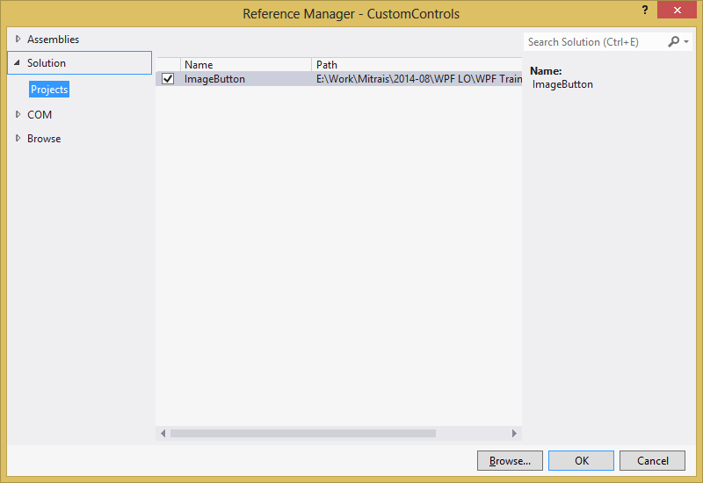
Creating and Using User-Defined Controls CustomControl (6)
Add Reference screen:

Slide 94
Creating and Using User-Defined Controls CustomControl (7)
MainWindow.xaml:
<Window x:Class="CustomControls.MainWindow"
xmlns="http://schemas.microsoft.com/winfx/2006/xaml/presentation"
xmlns:x="http://schemas.microsoft.com/winfx/2006/xaml"
xmlns:local="clr-namespace:CustomControls"
xmlns:imageButton="clr-namespace:ImageButton;assembly=ImageButton"
Title="MainWindow" Height="250" Width="525">
<Grid>
<Grid.RowDefinitions>
<RowDefinition Height="100"/>
<RowDefinition Height="*"/>
</Grid.RowDefinitions>
<local:XAMLFileBrowser Grid.Row="0" />
<imageButton:ImageButtonControl Grid.Row="1" Source="D:\LOGO.bmp">
Test Image Button
</imageButton:ImageButtonControl>
</Grid>
</Window>

Slide 95
Using Data Binding Dependency Properties (1)
DataBinding is a mechanism provided by WPF to auto-update data between the business model and the user interface
Every time the data of your business model changes, it automatically reflects the updates to the user interface and vice versa
This is the preferred method in WPF to bring data to the user interface
The source of a databinding can be a normal .NET property or a DependencyProperty
The target property of the binding must be a DependencyProperty

Slide 96
Using Data Binding Dependency Properties (2)
To make the databinding properly work, both sides of a binding must provide a change notification that tells the binding when to update the target value
On normal .NET properties this is done by raising the PropertyChanged event of the INotifyPropertyChanged interface
On DependencyProperties this is done by the PropertyChanged callback of the property metadata

Slide 97
Using Data Binding Dependency Properties (3)
Example (XAML):
<StackPanel>
<TextBox x:Name="txtInput" />
<Label Content="{Binding Text, ElementName=txtInput,
UpdateSourceTrigger=PropertyChanged}" />
</StackPanel>

Slide 98
Using Data Binding DataContext (1)
Every WPF control derived from FrameworkElement has a DataContext property
This property is meant to be set to the data object it visualizes
The DataContext property inherits its value to child elements

Slide 99
Using Data Binding DataContext (2)
Example (XAML):
<StackPanel DataContext="{StaticResource myCustomer}">
<TextBox Text="{Binding FirstName}"/>
<TextBox Text="{Binding LastName}"/>
<TextBox Text="{Binding Street}"/>
<TextBox Text="{Binding City}"/>
</StackPanel>

Slide 100
Using Data Binding ValueConverters (1)
A ValueConverter converts the value from a source type to a target type and back
A typical example is to bind a boolean member to the Visibility property

Slide 101
Using Data Binding ValueConverters (2)
Example (XAML):
<StackPanel>
<StackPanel.Resources>
<BooleanToVisibilityConverter x:Key="boolToVis" />
</StackPanel.Resources>
<CheckBox x:Name="chkShowDetails" Content="Show Details" />
<StackPanel x:Name="detailsPanel"
Visibility="{Binding IsChecked, ElementName=chkShowDetails,
Converter={StaticResource boolToVis}}">
</StackPanel>
</StackPanel>

Slide 102
Using Data Binding ValueConverters (3)
Example (code-behind):

Slide 103
Using Data Binding DataBinding (1)
MainWindow.xaml:
<Window x:Class="DataBinding.MainWindow"
xmlns="http://schemas.microsoft.com/winfx/2006/xaml/presentation"
xmlns:x="http://schemas.microsoft.com/winfx/2006/xaml"
Title="MainWindow" Height="350" Width="525" Loaded="Window_Loaded">
<Grid>
<TextBlock Text="{Binding FormattedDate, StringFormat=dd-MMMM-yyyy}" />
</Grid>
</Window>

Slide 104
Using Data Binding DataBinding (2)
MainWindow.xaml.cs – part 1:
using System;
using System.Collections.Generic;
using System.Linq;
using System.Text;
using System.Threading.Tasks;
using System.Windows;
using System.Windows.Controls;
using System.Windows.Data;
using System.Windows.Documents;
using System.Windows.Input;
using System.Windows.Media;
using System.Windows.Media.Imaging;
using System.Windows.Navigation;
using System.Windows.Shapes;
namespace DataBinding
{
/// <summary>
/// Interaction logic for MainWindow.xaml
/// </summary>
public partial class MainWindow : Window
{

Slide 105
Using Data Binding DataBinding (3)
MainWindow.xaml.cs – part 2:
private DateTime _formattedDate = new DateTime(2014, 8, 20);
public DateTime FormattedDate
{
get { return _formattedDate; }
set { _formattedDate = value; }
}
public MainWindow()
{
InitializeComponent();
}
private void Window_Loaded(object sender, RoutedEventArgs e)
{
this.DataContext = this;
}
}
}

Slide 106
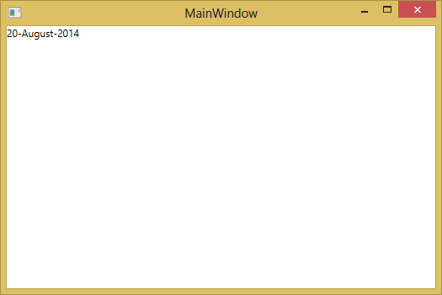
Using Data Binding DataBinding (4)
Result:

Slide 107
Using Data Binding DataBinding (5)
MainWindow.xaml (display format):
<Grid.Resources>
<Style x:Key="styleFormat" TargetType="TextBlock">
<Setter Property="TextDecorations" Value="Underline"></Setter>
</Style>
</Grid.Resources>
<TextBlock Text="{Binding FormattedDate, StringFormat=dd-MMMM-yyyy }" Style="{StaticResource styleFormat}" />

Slide 108
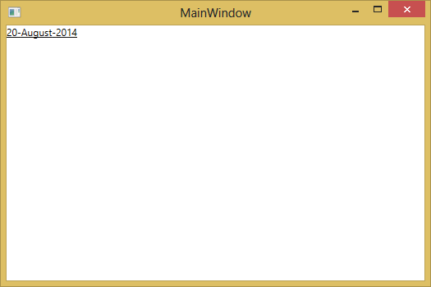
Using Data Binding DataBinding (6)
Result:

Slide 109
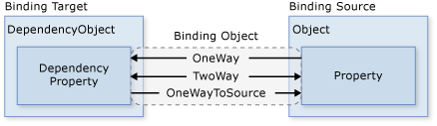
Using Data Binding DataBinding (7)
Binding directions:

Slide 110
Using Data Binding DataBinding (7)
Binding directions:
OneWay binding causes changes to the source property to automatically update the target property, but changes to the target property are not propagated back to the source property
TwoWay binding causes changes to either the source property or the target property to automatically update the other
OneWayToSource updates the source property when the target property changes
OneTime binding causes the source property to initialize the target property, but subsequent changes do not propagate

Slide 111
Using Input Validation and Dialogs Input Validation (1)
IP4ValidationRule.cs – part 1:
using System;
using System.Globalization;
using System.Windows.Controls;
namespace InputValidation
{
class IP4ValidationRule : ValidationRule
{
public override ValidationResult Validate(object value, CultureInfo cultureInfo)
{
var str = value as string;
if (String.IsNullOrEmpty(str))
{
return new ValidationResult(false,
"Please enter an IP Address.");
}
var parts = str.Split('.');
if (parts.Length != 4)
{
return new ValidationResult(false,
"IP Address should be four octets, seperated by decimals.");
}

Slide 112
Using Input Validation and Dialogs Input Validation (2)
IP4ValidationRule.cs – part 2:
foreach (var p in parts)
{
int intPart;
if (!int.TryParse(p, NumberStyles.Integer,
cultureInfo.NumberFormat, out intPart))
{
return new ValidationResult(false,
"Each octet of an IP Address should be a number.");
}
if (intPart < 0 || intPart > 255)
{
return new ValidationResult(false,
"Each octet of an IP Address should be between 0 and 255.");
}
}
return new ValidationResult(true, null);
}
}
}

Slide 113
Using Input Validation and Dialogs Input Validation (3)
ErrorToMessageConverter.cs:
using System;
using System.Collections.ObjectModel;
using System.Linq;
using System.Text;
using System.Windows.Controls;
using System.Windows.Data;
namespace InputValidation
{
public class ErrorsToMessageConverter : IValueConverter
{
public object Convert(object value, Type targetType, object parameter,
System.Globalization.CultureInfo culture)
{
var sb = new StringBuilder();
var errors = value as ReadOnlyCollection<ValidationError>;
if (errors != null)
{
foreach (var e in errors.Where(e => e.ErrorContent != null))
{ sb.AppendLine(e.ErrorContent.ToString()); }
}
return sb.ToString();
}
public object ConvertBack(object value, Type targetType, object parameter,
System.Globalization.CultureInfo culture)
{
throw new NotImplementedException();
}
}
}

Slide 114
Using Input Validation and Dialogs Input Validation (4)
MainWindow.xaml:
<Window x:Class="InputValidation.MainWindow"
xmlns="http://schemas.microsoft.com/winfx/2006/xaml/presentation"
xmlns:x="http://schemas.microsoft.com/winfx/2006/xaml"
xmlns:local="clr-namespace:InputValidation"
Title="MainWindow" Height="350" Width="525" Loaded="Window_Loaded">
<Window.Resources>
<local:ErrorsToMessageConverter x:Key="eToMConverter" />
</Window.Resources>
<StackPanel Margin="5">
<TextBlock Margin="2">Enter An IPv4 Address:</TextBlock>
<TextBox x:Name="AddressBox">
<TextBox.Text>
<Binding Path="IPAddress" UpdateSourceTrigger="PropertyChanged">
<Binding.ValidationRules>
<local:IP4ValidationRule />
</Binding.ValidationRules>
</Binding>
</TextBox.Text>
</TextBox>
<TextBlock Margin="2" Foreground="Red" FontWeight="Bold"
Text="{Binding ElementName=AddressBox, Path=(Validation.Errors), Converter={StaticResource eToMConverter}}" />
<Button Name="SubmitButton" Content="Submit"/>
</StackPanel>
</Window>

Slide 115
Using Input Validation and Dialogs Input Validation (5)
MainWindow.xaml.cs – part 1:
using System;
using System.Collections.Generic;
using System.Linq;
using System.Text;
using System.Threading.Tasks;
using System.Windows;
using System.Windows.Controls;
using System.Windows.Data;
using System.Windows.Documents;
using System.Windows.Input;
using System.Windows.Media;
using System.Windows.Media.Imaging;
using System.Windows.Navigation;
using System.Windows.Shapes;
namespace InputValidation
{
/// <summary>
/// Interaction logic for MainWindow.xaml
/// </summary>
public partial class MainWindow : Window
{
private string _ipAddress = "1.1.1.1";
public string IPAddress
{
get { return _ipAddress; }
set { _ipAddress = value; }
}

Slide 116
Using Input Validation and Dialogs Input Validation (6)
MainWindow.xaml.cs – part 2:
public MainWindow()
{
InitializeComponent();
}
private void Window_Loaded(object sender, RoutedEventArgs e)
{
this.DataContext = this;
}
}
}

Slide 117
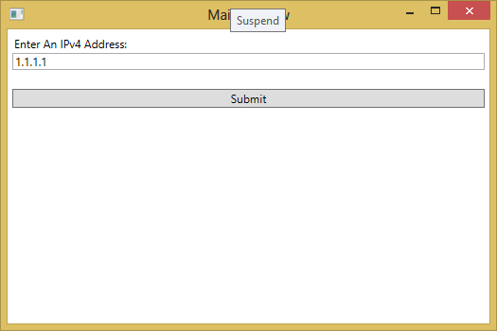
Using Input Validation and Dialogs Input Validation (7)
Result (initial screen):

Slide 118
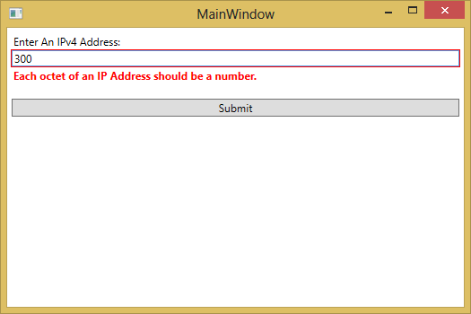
Using Input Validation and Dialogs Input Validation (8)
Result (error warning):

Slide 119
Using Input Validation and Dialogs Using Dialogs (1)
We can also use the built-in .NET dialog boxes to show the validation messages

Slide 120
Using Input Validation and Dialogs Using Dialogs (2)
MainWindow.xaml:
<Window x:Class="InputValidation.MainWindow"
xmlns="http://schemas.microsoft.com/winfx/2006/xaml/presentation"
xmlns:x="http://schemas.microsoft.com/winfx/2006/xaml"
xmlns:local="clr-namespace:InputValidation"
Title="MainWindow" Height="350" Width="525" Loaded="Window_Loaded">
<Window.Resources>
<local:ErrorsToMessageConverter x:Key="eToMConverter" />
</Window.Resources>
<StackPanel Margin="5">
<TextBlock Margin="2">Enter An IPv4 Address:</TextBlock>
<TextBox x:Name="AddressBox">
<TextBox.Text>
<Binding Path="IPAddress" UpdateSourceTrigger="PropertyChanged">
<Binding.ValidationRules>
<local:IP4ValidationRule x:Name="ValidationRule" />
</Binding.ValidationRules>
</Binding>
</TextBox.Text>
</TextBox>
<TextBlock Margin="2" Foreground="Red" FontWeight="Bold"
Text="{Binding ElementName=AddressBox, Path=(Validation.Errors), Converter={StaticResource eToMConverter}}" />
<Button Name="SubmitButton" Content="Submit" Click="SubmitButton_Click"/>
</StackPanel>
</Window>

Slide 121
Using Input Validation and Dialogs Using Dialogs (2)
MainWindow.xaml.cs – part 1:
using System;
using System.Collections.Generic;
using System.Linq;
using System.Text;
using System.Threading.Tasks;
using System.Windows;
using System.Windows.Controls;
using System.Windows.Data;
using System.Windows.Documents;
using System.Windows.Input;
using System.Windows.Media;
using System.Windows.Media.Imaging;
using System.Windows.Navigation;
using System.Windows.Shapes;
using System.Globalization;
namespace InputValidation
{
/// <summary>
/// Interaction logic for MainWindow.xaml
/// </summary>
public partial class MainWindow : Window
{
private string _ipAddress = "1.1.1.1";
public string IPAddress
{
get { return _ipAddress; }
set { _ipAddress = value; }
}

Slide 122
Using Input Validation and Dialogs Using Dialogs (3)
MainWindow.xaml.cs – part 2:
public MainWindow()
{
InitializeComponent();
}
private void Window_Loaded(object sender, RoutedEventArgs e)
{
this.DataContext = this;
}
private void SubmitButton_Click(object sender, RoutedEventArgs e)
{
ValidationResult validationResult = ValidationRule.Validate(AddressBox.Text, CultureInfo.CurrentCulture);
if (!validationResult.IsValid)
{
MessageBox.Show(validationResult.ErrorContent.ToString(), "Warning", MessageBoxButton.OK);
}
else
{
MessageBox.Show("Data is valid.", "Information", MessageBoxButton.OK);
}
}
}
}

Slide 123
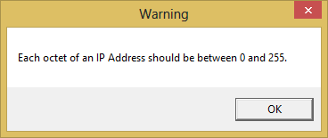
Using Input Validation and Dialogs Using Dialogs (4)
Result:

Slide 124
Using Input Validation and Dialogs Using Dialogs (5)
MainWindow.xaml.cs:
private void SubmitButton_Click(object sender, RoutedEventArgs e)
{
if (MessageBox.Show("Do you want to submit the data?", "Confirmation", MessageBoxButton.YesNo) == MessageBoxResult.Yes)
{
ValidationResult validationResult = ValidationRule.Validate(AddressBox.Text, CultureInfo.CurrentCulture);
if (!validationResult.IsValid)
{
MessageBox.Show(validationResult.ErrorContent.ToString(), "Warning", MessageBoxButton.OK);
}
else
{
MessageBox.Show("Data is valid.", "Information", MessageBoxButton.OK);
}
}
}

Slide 125
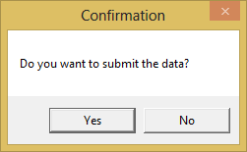
Using Input Validation and Dialogs Using Dialogs (6)
Result:

Slide 126
Creating and Using Context Menu (1)
Context Menus can be defined on any WPF controls
The items of a context menu are normal MenuItems

Slide 127
Creating and Using Context Menu (2)
MainWindow.xaml:
<Window x:Class="ContextMenu.MainWindow"
xmlns="http://schemas.microsoft.com/winfx/2006/xaml/presentation"
xmlns:x="http://schemas.microsoft.com/winfx/2006/xaml"
Title="MainWindow" Height="350" Width="525">
<Grid>
<TextBlock Text="Test" Width="400" Height="100">
<TextBlock.ContextMenu>
<ContextMenu>
<MenuItem Command="Cut">
</MenuItem>
<MenuItem Command="Copy">
</MenuItem>
<MenuItem Command="Paste">
</MenuItem>
</ContextMenu>
</TextBlock.ContextMenu>
</TextBlock>
</Grid>
</Window>

Slide 128
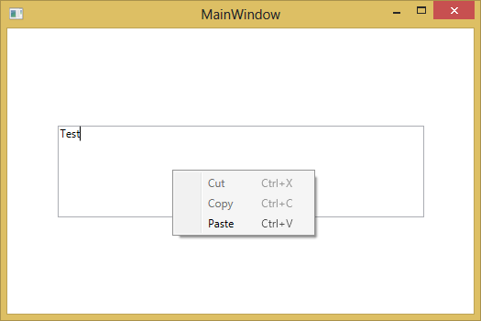
Creating and Using Context Menu (3)
Result:

Slide 129
Questions?

Slide 130
Session 6

Slide 131
Final Test

Slide 132
You have completed the XAML, WPF AND WPF STYLE Learning Offering.
Feel free to contact the subject matter expert to discuss this topic further.
Thank you!

